Slide 1
A Matrix Implementation In Java
Brendan Caudill
Truman Senior Computer Science Capstone
Spring 2019

Slide 2

Project
Represent the majority of MATH285 coursework
Create code based on MATH285 knowledge and documentation
Use Matrix class to demonstrate usage of Matrices to solve different problems

Slide 3
Main Creations
Matrix package
  Matrix class
  MatrixTools class
MatrixTester package
  System of Equations Simplifier
  Markov Chains
  Linear Dependence
  Span
  General Tester

Slide 4
Matrix Package
Matrix class
  Basic Setters/Getters
  Dimension Checkers
  Row Operations
  Matrix Operations
  Gaussian/Gauss-Jordan Elimination
  Matrix Inversion
  Determinants
  Rank and Nullity
  LU Decomposition
MatrixTools class
  Basic Matrix Operations with Static Methods
    add(Matrix1, Matrix 2) instead of Matrix1.add(Matrix2)

Slide 5
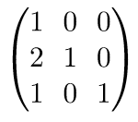
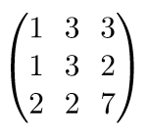
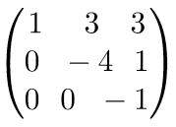
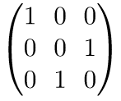
Challenges
Implementing work done by hand in code
Debugging confusing loops (and writing them cleanly)
LU Decomposition
  Doolittle’s Method?
  Crout’s Method?
  Course material?
L =
A =
U =
P =

Slide 6
Interesting Things Learned
The relation between nullity and linear independence
The relation between span, linear independence, and the number of solutions a system of equations has
  A system has infinitely many solutions when linearly dependent
  A system has exactly one solution when linearly independent
  A system has no solutions if the vectors don’t span
How an identity matrix represents row operations

Slide 7
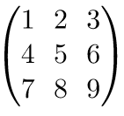
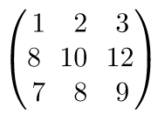
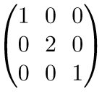
Identity Matrices and Row Operations
Can I implement row operations with matrices and existing matrix operations?
2*row2
=

Slide 8
Pitfalls
Implementation was much more simpler than predicted
Attempt to use more Classes unsuccessful
  Result was singular, very large, class
Excessive Code Reuse
  Gaussian Elimination
  Gauss-Jordan Elimination
  Determinants
  LU Factorization

Slide 9
Successes
Snowball effect
  Row Ops → Gaussian Elimination → Determinants
  Row Ops → Gaussian Elimination → Rank → Nullity → Linear Dependence
Improved Understanding of MATH285
Practice in Loop Analysis

Slide 10
Conclusion
Converting coursework to code as a learning tool
Self-driven development can be difficult
  Feature-creep
  Out of order implementation (Or top-down design?)
  Low guidance

Slide 11
Links and Information
At my Github is the project and documents
  Github link: https://github.com/Bgc1713/capstone
  Github link to pull: https://github.com/Bgc1713/capstone.git

